Slide 1
Open Innovation Tools for Collaboration NASA’s Toolkit for Innovation using Prizes and Challenges with the Curated Communities
NASA’s Center of Excellence for Collaborative Innovation (CoECI)
Steve Rader steven.n.rader@nasa.gov
@NASA_NTL
Notes:
VERSION: 2.19.2015 8:24 AM

Slide 2







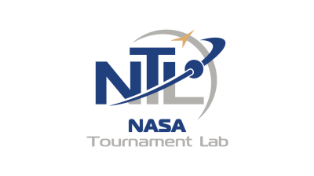

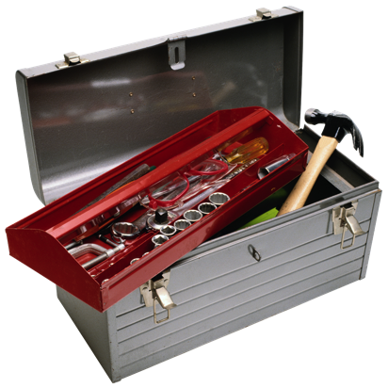










NASA’s Center of Excellence for Collaborative Innovation
The Center of Excellence for Collaborative Innovation (CoECI) is working across NASA and other federal agencies to infuse crowdsourcing methods as set of available tools for engineers and scientists on projects where applicable.
CoECI has the contracts in place with multiple vendors and works with both users and vendors (formulation, management, performance metrics).
NEW set of tools in the toolkit for NASA challenge owners
NASA@Work – NASA’s Internal Crowd Challenge Platform
Innocentive Contract
Technology Scouting
Yet.com Contract
NASA Tournament Lab (NTL)
NOIS Contract Vendors: Appirio/TopCoder, Common Pool, HeroX, InnoCentive, Kaggle, Luminary Labs, NineSigma, OpenIDEO, Patexia, Tongal
Small purchase challenge vendors
GrabCAD, Freelancer, etc. via Gov’t Purchase Card
Other NASA Crowd-Based/Challenge Programs
NASA Centennial Challenges – Similar to X-Prize competitions
SpaceApps & Citizen Science Challenges
Notes:
Note that NASA also has a challenges and prizes office (Larry Cooper and Jen Gustetic at OCT/HQ) who run competitions which involve actually building and demonstrating (and have large prizes)
The Green Flight Challenge: 4 seater aircraft 100 mi per energy equiv of ½ gallon of gas per passenger. $1.6M PRIZE
2 Teams achived goal – Winning team BY A FACTOR OF 2
$6M spent by all teams (multiplier affect)… win-win… these teams are leveraging their work for commercial benefit.
Sample Return Robot challenge $1.5M (Just had Level 1 winner of $5K)

Slide 3

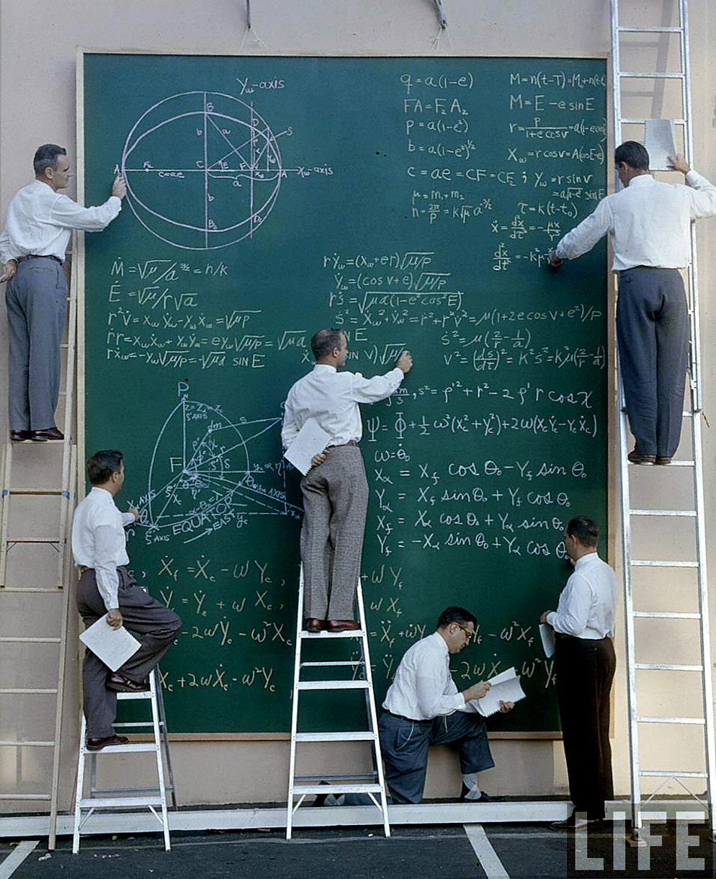
First Things First!
NASA has some of the most amazing employees on the PLANET!
Tap into that crowd FIRST!

Slide 4

What Is NASA@work?
A NASA-wide crowdsourcing platform for employees to find technical solutions, new ideas, or expertise using prize-based challenges.
How Can NASA@work Be Used?
Generate new ideas, concepts
Collect new and creative input
Survey NASA for knowledge or expertise
Refine a challenge prior to external crowdsourcing
NASA@work is FREE for any NASA projects that want to post a challenge!
Notes:
SEE IF WE CAN DELETE THIS???

Slide 5
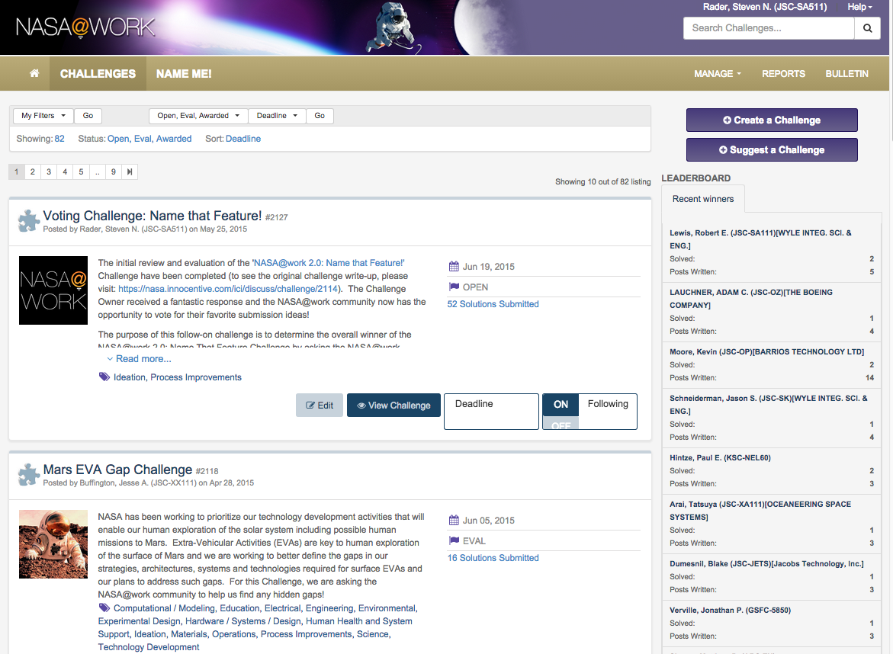

Slide 6
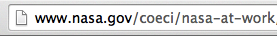
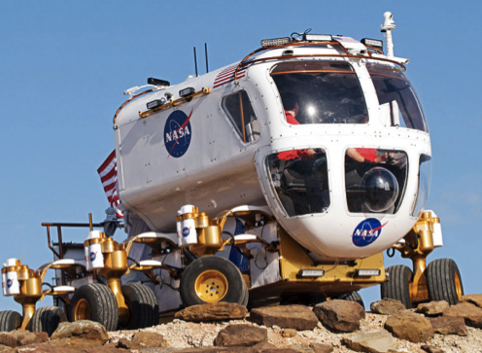
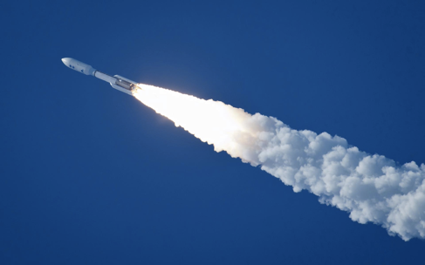
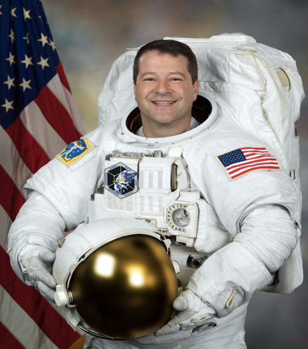
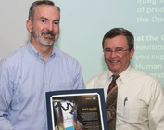
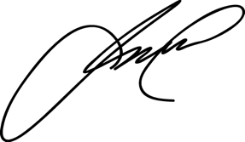
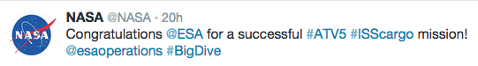
Solver Reward System
NASA External Public Recognition
Cool NASA Experience
Item Flown in Space
Recognition by Center Director and Agency Management
Astronaut Autographed Item
Social Media Recognition from Astronaut
Congratulations @JohnJames for your winning NASA@work
Award #NASA@work #NASA #JohnJamesRocks

Slide 7
Successful Challenges
Group On-Call Notification Alternatives
Ideas for New Technology Demonstration Prize Competitions
Lab Equipment Obsolescence: Cytometer
Deep Space Human Spacecraft
Display Format Development System
Inflight Calcium Isotope Measurement Device
Protection of the Human from Galactic Cosmic Rays Challenge
Solutions on the Use of Thorium Instead of Uranium
Packing Foam Alternatives Challenge
As Good as Dollars: Incentives for NASA@work that Count!
A Durable/ Permanent Anti-Fog for the Space Suit Helmet
Reduce Waste in Space: Creating Feedstock for Additive Manufacturing (3D Printing)
Determining Urine Volume in Microgravity
Hands-On Tutorial for Reed Solomon Encoding Method
Advanced Exercise Concepts for Long-Duration Space Flight
Notes:
Here are just some of the challenges that we’ve run on our NASA@work platform over the last year.
Note that these are both technical and non-technical
A great example was a group who was working on an improved method of determining Urine Volume in microgravity…. I ended up that a group that worked not more than 300 yards away was working on the same thing and had exactly what was needed. NASA is BIG… NASA@work can help make the connections to make it smaller.

Slide 8
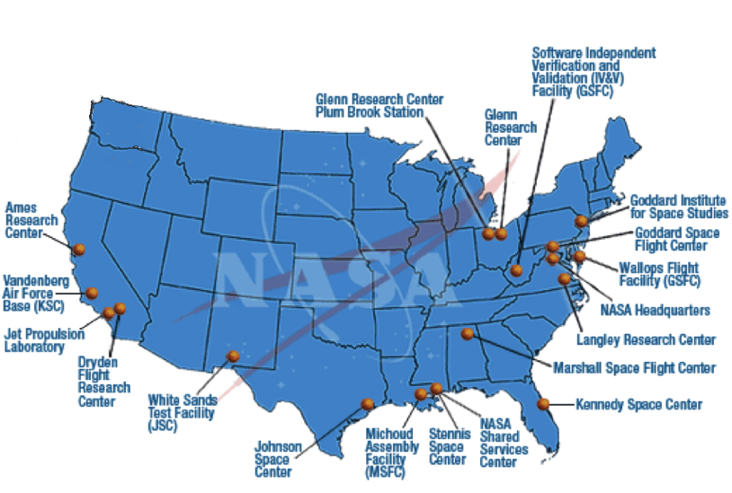
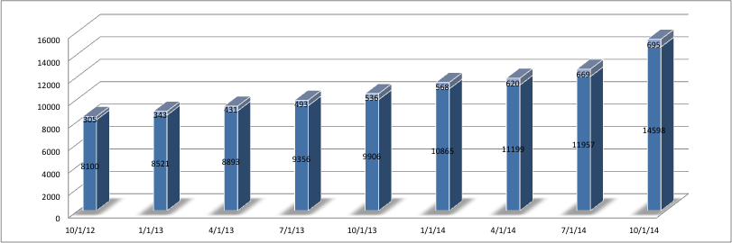
Over 16,000 Registered Members
(25% of NASA’s 60,000 CS & Contractor Workforce)
People that work at NASA want to make a difference!
15-20 Challenges per Year
2-4 Active challenges posted at any one time
New challenge posts every ~2-3 weeks
Growth of the NASA@work Community since October 2012

Slide 9
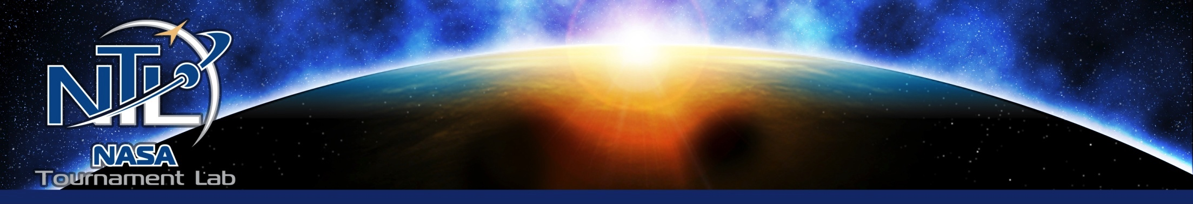
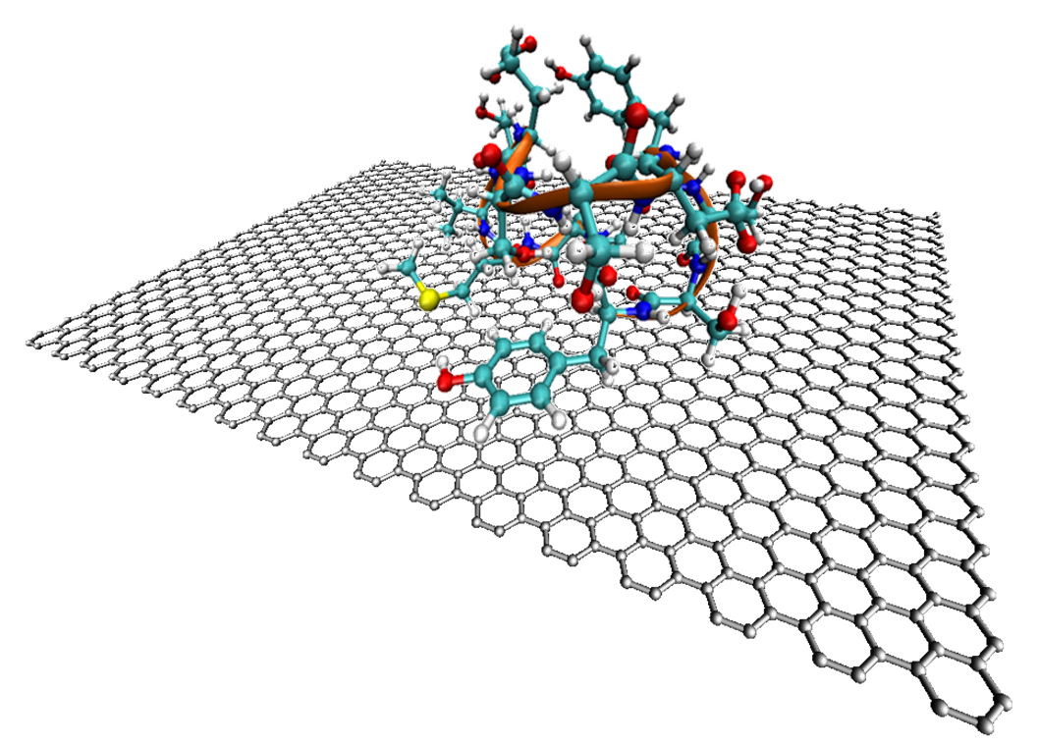
Searching for Technologies
Using New Methods to Search for New and Emerging Technology to Meet NASA’s Needs

Slide 10
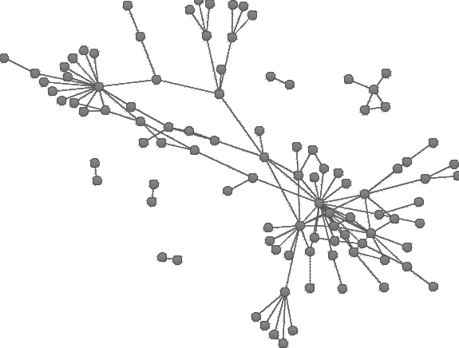
Yet2.com
Provides a “matching” service that finds technologies and solutions from industry, academia, and/or individuals for a given need/challenge.
Includes a 130,000 member community and links to over 16,000 commercial entities.
Very effective (and cost effective) in searching for existing products or development efforts.

Slide 11
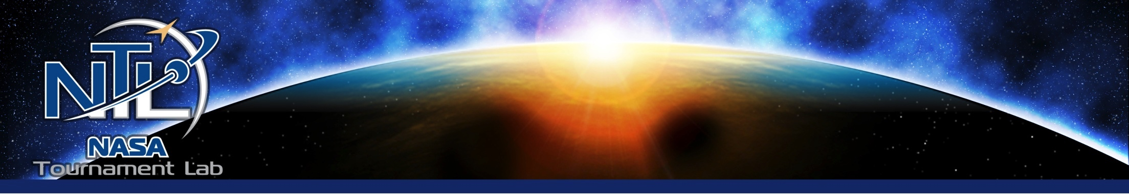
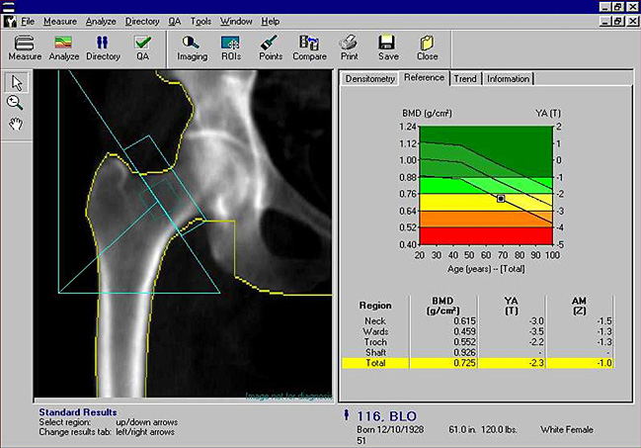

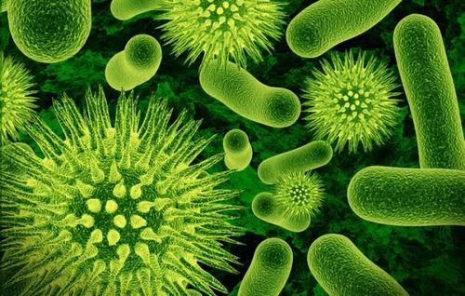
Yet2.com Challenges
Bone Density Measurement
Non-Invasive Intra-Cranial Pressure Measurement
“Much more than we expected! Very pleasantly surprised that this process exposed so many potential solutions with such wide breadth and depth”
“Learned that we should have revisited technologies that we rejected earlier
81 Leads Identified
63 Rejected
3 High Interest Solutions
5 Other Interesting Solutions
6 Potential Complementary
Technologies
2 Potential Solutions
Monitoring of Water and Biocides
Notes:
There is no validated tool to quantify intracranial pressure non-invasively.
Clinical Gold Standard methods are invasive
Lumbar puncture
Cranial implant
Accurate pre-, in-, and postflight ICP measurements are required to prove or disprove the intracranial pressure hypothesis and quantify the extent and time course of ICP changes.
Techwatch and market surveys indicated that the current state of technology was insufficient to meet NASA’s research needs.

Slide 12
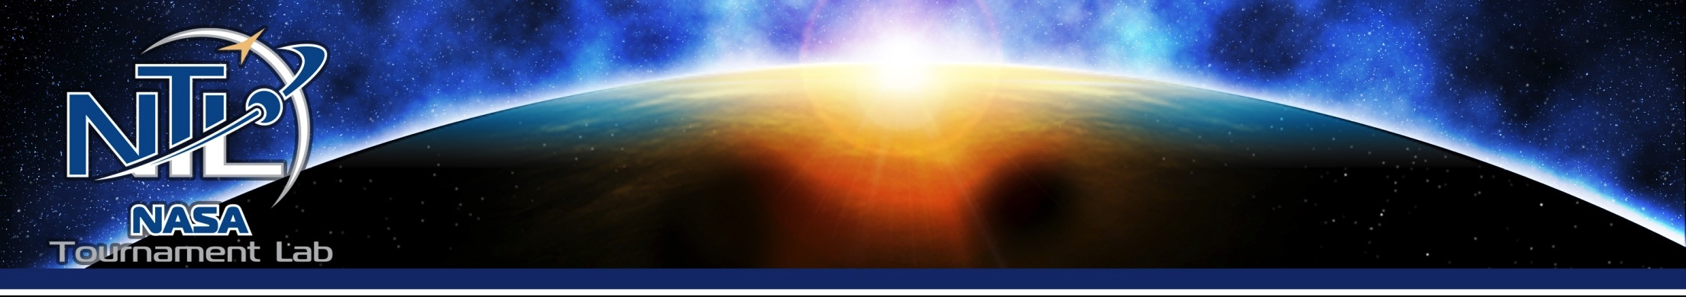

Non-
NASA CoECI’s Open Innovation Capabilities
Enterprise Knowledge Sharing
CAD Design
Tech Survey
Algorithms
Graphics
Logos
Light SW
Big Data
Develop an
Innovative Solution
Ideation
Prototyping
Develop
Software Solution
Conceptualization
IP Search
Find an
Innovative Solution
Videos
http://nasa.innocentive.com
http://www.nasa.gov/offices/COECI

Slide 13





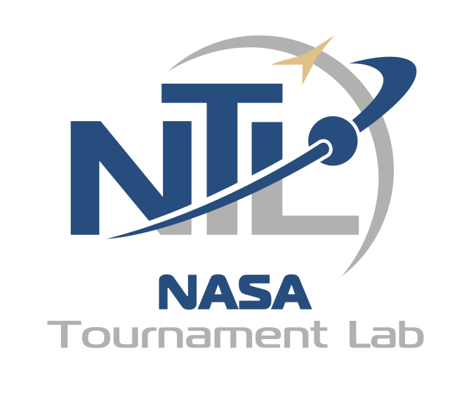

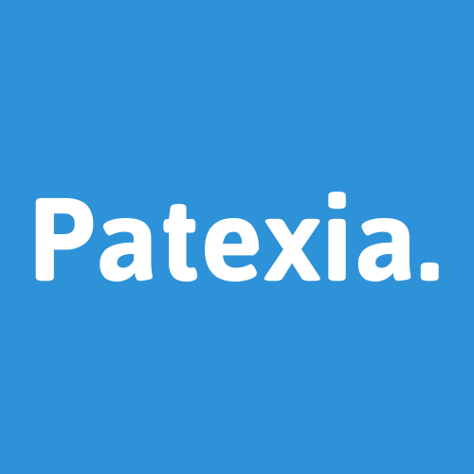



Non-
NASA CoECI’s Open Innovation Toolkit
GSA IT Software
NASA Tournament Lab (NTL) = NASA Open Innovation Services (NOIS) Contract
http://nasa.innocentive.com
http://www.nasa.gov/offices/COECI

Slide 14
Non-
BACKUP

Slide 15

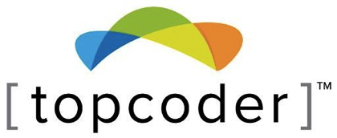
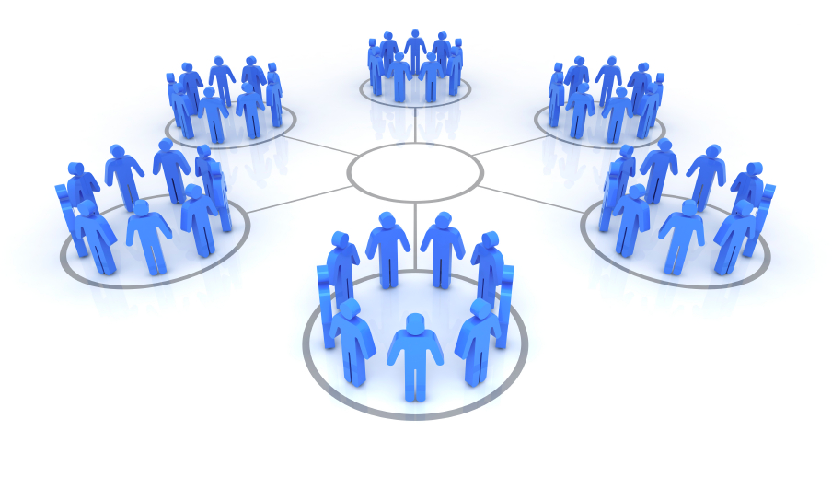



Networks & Communities
Inventors
Problem Solvers
1,130,000
Software Coders
355,000
800,000
Freelance Workers
Film-Makers
15,600,000
50,000
Engineers & Designers
2,140,000
Curated Communities
Well formulated crowd-based platforms actively work to
build a community of users that are passionate enthusiasts.
Notes:
Initially people started forming communities using things like bulletin boards… remember those…
But then with the web, companies started understanding various value propositions in helping these communities.

Slide 16

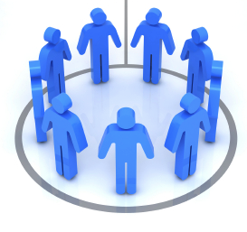
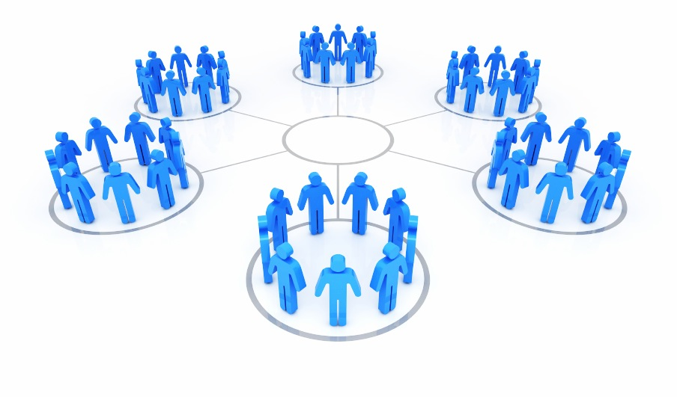




Effectively Using Communities
Solve a Problem
Develop a Product
Provide a Service
Create an Innovative New Solution
Access Best Possible Product or Service
(competition winner)
Access Very Specific Expertise
(found through competition)
Apply an Existing Technology
(in an innovative way)
Find an
Existing
Solution
(you didn’t know existed)
Diverse Membership
Expert or Domain Focused Membership
Innovation from Diversity found via Challenges
(Experience, Context/Perspective, Expertise)
High Quality Products/Services
(via Competition to get Best in Domain)
16

Slide 17
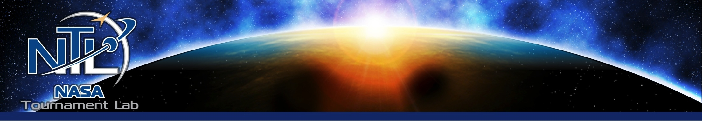

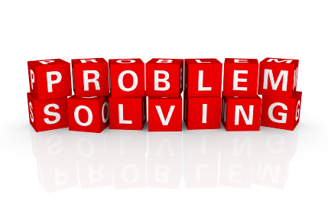
Innovation & Problem Solving
Using Challenges with Diverse Communities to develop unique and innovative approaches to unsolved problems
Notes:
Wait… before you roll your eyes!!! Innovation is real…. You’ve seen it…. You’ve experienced it… it is that idea that seems obvious in retrospect… “why didn’t I think of that”…. Its that “different” approach that works out spectacularly… unexpectedly…
We are usually looking for ideas…. Maybe “out of the box” thinking…. Maybe its ideas on how to solve a really hard problem… the kind that may not even have a solution.

Slide 18
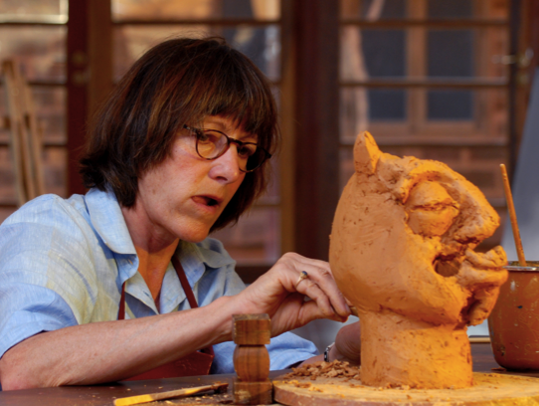
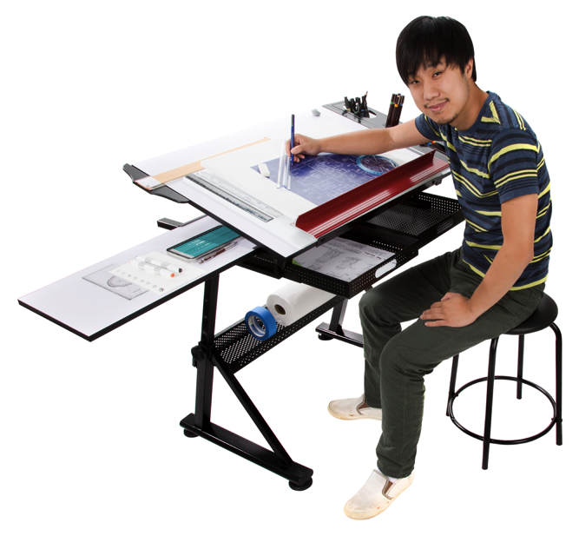

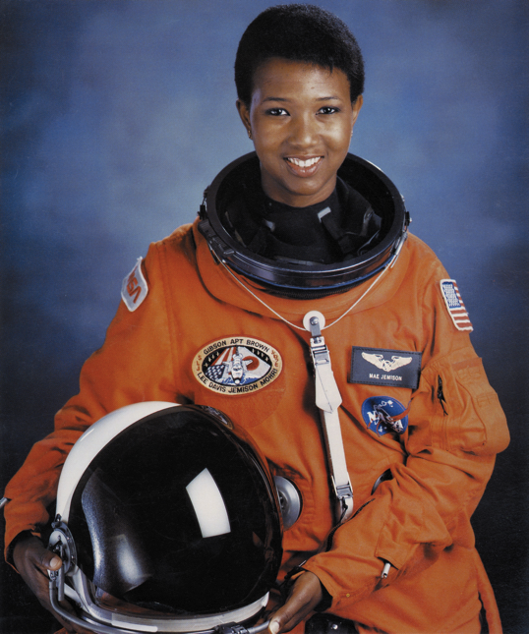


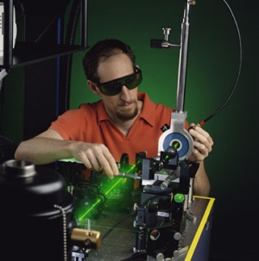

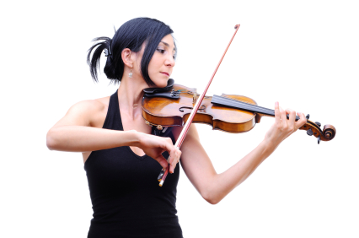
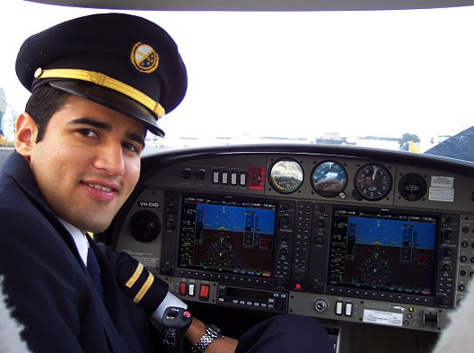
Diversity is the Key to Innovation
One MIT study into InnoCentive revealed that solvers were more successful when they had less experience in the relevant discipline.
Some data suggests that as much as 70% of successful InnoCentive challenge solutions are solved by individuals outside of the challenge’s specific technical domain.

Slide 19
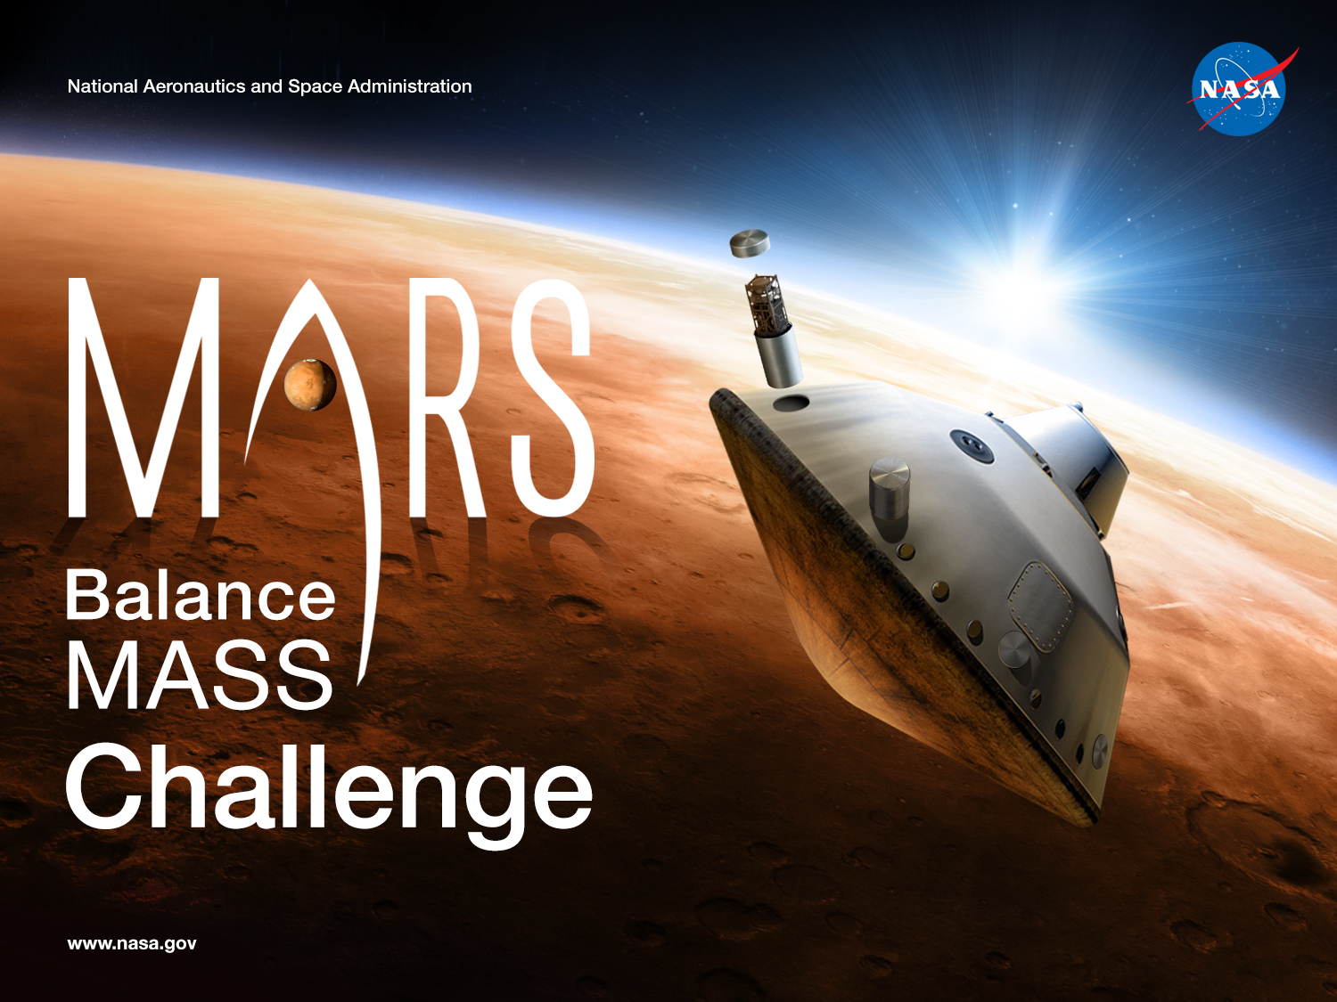
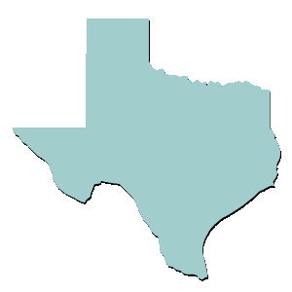
Winner was Ted Ground from Rising Star, Texas
(population 799)
$20,000 in prizes
Over 2800 registrants
219 Entries
Winning Submission: Barium tracers for atmospheric analysis
Notes:
(Mars 2020 mission is considering a late change to include this in the design)
Solver is from Rising Star, TX (population 800)…. How would we have found this idea if we were not using challenges?
For about 5 years now, I have been self-employed as a technical consultant for a wide range of science and technology interests and enterprises.
Master’s degree in Aquatic Biology from Texas State University.
“it sort of came naturally, as a creative process, and I appreciate opportunities to be creative. “
Spent 80-100 hours on his submission
“Participating in this NASA Challenge has encouraged me to participate in 11 other InnoCentive Challenges, in very diverse areas where I’ve really “pushed the envelope” out of my confidence or comfort zone. “

Slide 21
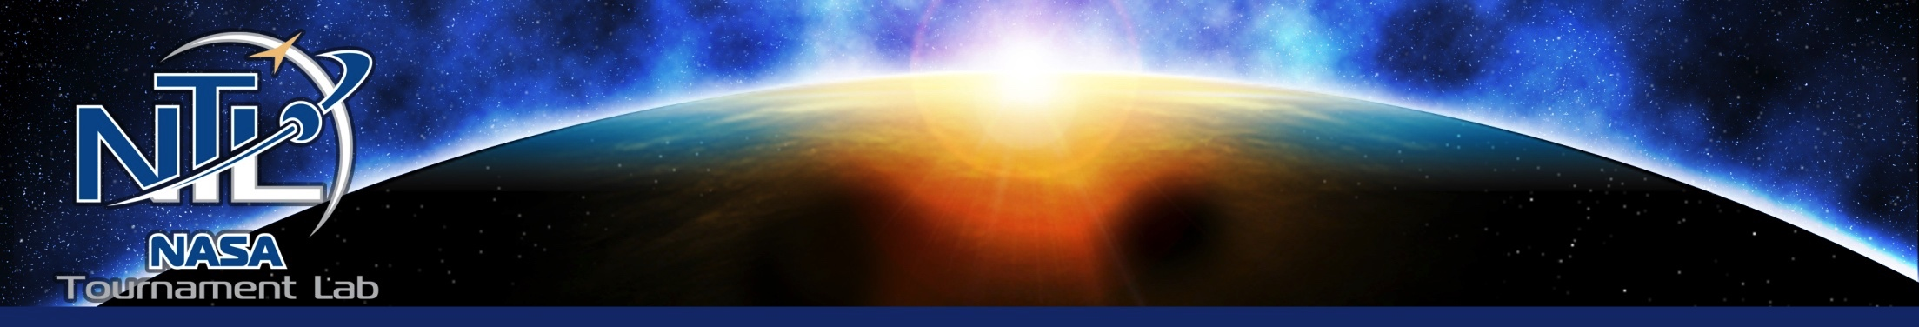
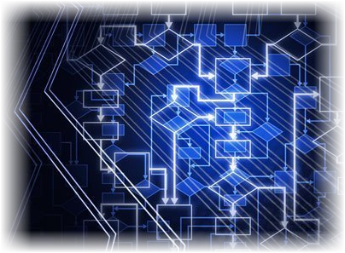
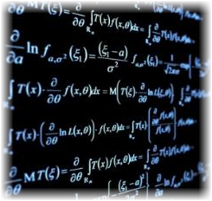
Algorithm Competitions
Leverage Competition to Optimize Complex Algorithmic Problems

Slide 22

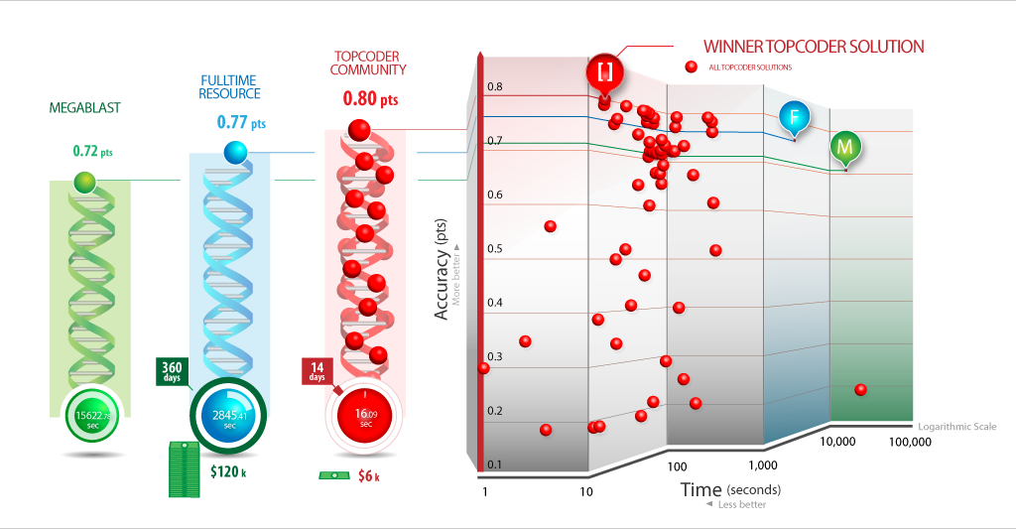


Winning solution performs 120x faster
ANTIBODY SEQUENCE ANNOTATION
Improve on NIH MegaBlast algorithm
for nucleotide sequence alignment
$2M+
Multi-year
Development
Source:
4.3 hours
47 min.
16 sec.
122
654
89
5

Slide 23
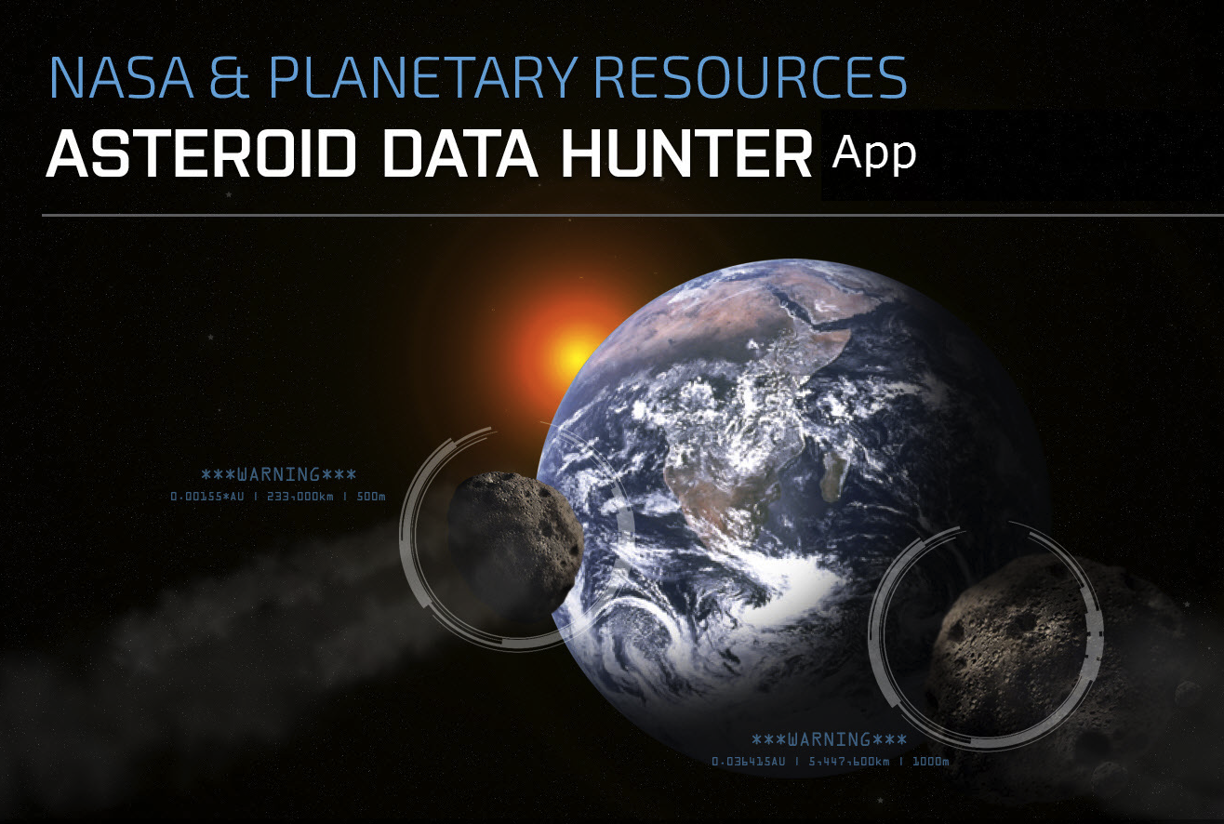
15% Improvement!
Over current method of identifying asteroids in the main belt of Asteroids that orbit between Mars & Jupiter
1241 Registrants
625 Solutions Submitted
$74,124 in Prizes Awarded
Algorithm AND App
Notes:
Launched in March of 2014 and in 10.5 months got an algorithm that is 15% better at detecting asteroids (than the standard: catalina sky survey) AND buidlng an app that citizen scientists, hobbyist astronomers and even professional organizations/institutions can download and use.
The can feed their images into the algorithm and if an asteroid is detected, they can automatically upload their findings to the pros that are officially tracking asteroids for the planet! All for less than $200K… a bit less than the cost of a single full time engineer for 10.5 months.

Slide 25
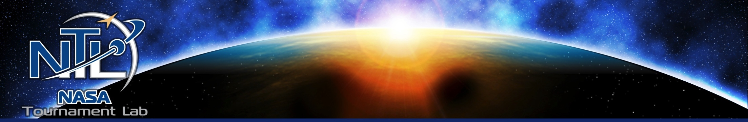
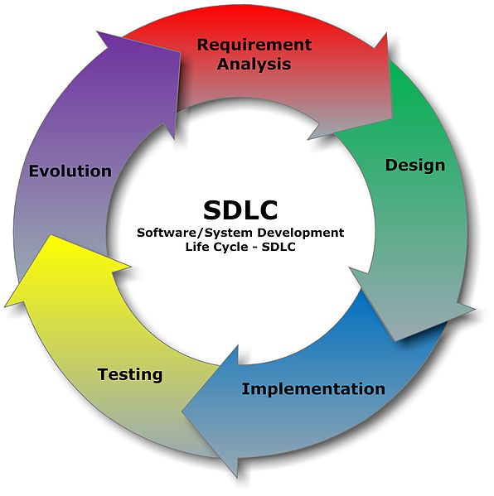
Using Competitions for Software Development
Conceptualization
Specification
Idea Generation
Wireframes
Storyboards
Architecture
Bug Hunt
Assembly
Bug Race
Component Dev
Image Credit: Wikipedia, Systems development life-cycle, http://en.wikipedia.org/wiki/Systems_development_life-cycle (as of Mar. 27, 2013, 05:48 GMT).
Source:
Notes:
<Go through the list>
Additionally in other agencies:
EPA – Mobile app for Cyanobacteria, Toxcast
DOE – Wave Energy
CMS – A number of apps
OPM – Payment app
DoD – Possible Exoskeleton
DOJ – Possible crime pattern algorithm

Slide 26
Notes:
<Go through the list>
Additionally in other agencies:
EPA – Mobile app for Cyanobacteria, Toxcast
DOE – Wave Energy
CMS – A number of apps
OPM – Payment app
DoD – Possible Exoskeleton
DOJ – Possible crime pattern algorithm

Slide 27
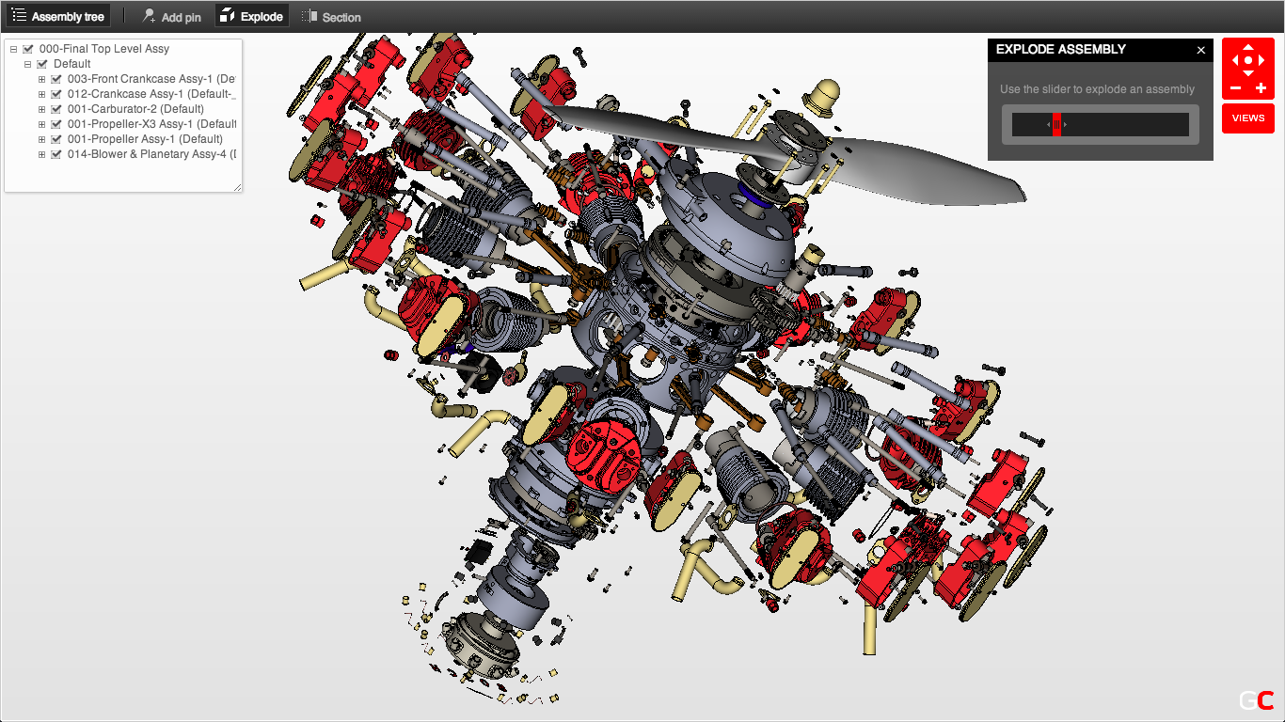
Design Challenges
Leverage Competition to Optimize Engineering Designs

Slide 28
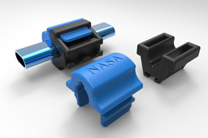
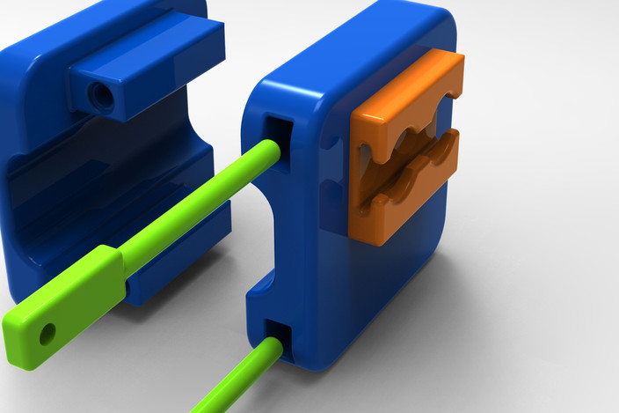
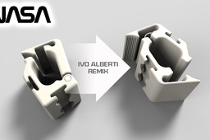
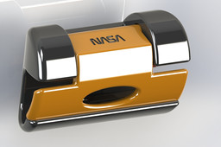
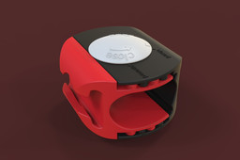
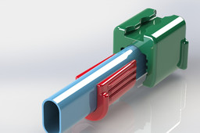



GrabCAD 30 Day challenge for $3000: 492 CAD Designs Submitted

